Slide 1


Unlocking the Path to Successful Learning
Discover the secrets to effective learning with these essential tips and strategies. Get ready to unleash your full potential!

Slide 2

The Power of Motivation and Mindset
1
The Fuel for Success 🔥
Explore how the right motivation can ignite your learning journey, making every challenge an opportunity for growth.
2
Cultivating a Growth Mindset 🌱
Develop a mindset that embraces challenges and fosters resilience, allowing you to thrive in any learning environment.

Slide 3
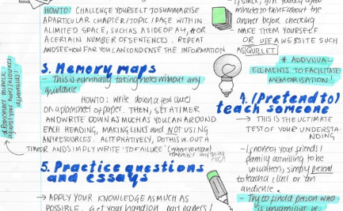
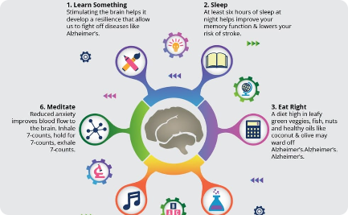

Mastering Study Techniques and Strategies
Study Smarter, Not Harder 🧠
Boosting Memory and Retention 📚
Harnessing Time Management Skills ⏳
Discover proven study techniques and strategies to maximize your learning potential and retain information effectively.
Unleash the power of memory techniques, mnemonics, and mind mapping to optimize your recall and enhance your understanding.
Learn valuable time management techniques to create a balance between your academic pursuits and personal life.

Slide 4
Utilizing Technology for Enhanced Learning
Embracing EdTech Innovations 🚀
Online Resources at Your Fingertips 💻
Virtual Learning Communities 🌐
Explore how educational technology can transform your learning experience, from interactive apps to virtual simulations.
Discover a world of online resources, from educational websites to video platforms, that can revolutionize your learning journey.
Connect with like-minded learners globally, expand your knowledge, and engage in collaborative projects through online learning communities.

Slide 5
The Art of Active Learning and Practice
1
Engaging with Hands-On Activities ✋
Dive into active learning methods that encourage exploration, experimentation, and practical application of knowledge.
The Power of Reflection ✨
2
Learn how self-reflection drives deeper understanding, enabling you to make connections and discover insights along your learning journey.
3
Testing and Self-Assessment 📝
Discover the benefits of regular testing and self-assessment as powerful tools to reinforce learning and identify areas for improvement.

Slide 6

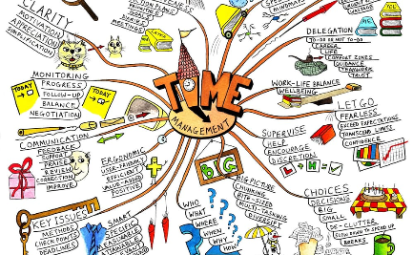
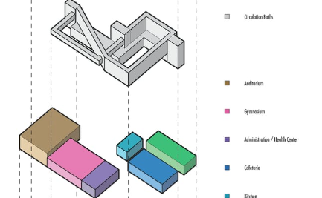
Visual Aids and Graphic Organizers
The Power of Visualization 📊
Organizing Ideas Effectively 🌪️
Creating Clear Connections 🧩
Unleash the potential of visual aids and infographics to simplify complex concepts, improve comprehension, and enhance memory retention.
Explore the art of creating mind maps, concept maps, and graphic organizers to help structure information and boost your learning capabilities.
Learn how diagrams and flowcharts can visually represent relationships and processes, enabling you to grasp complex subjects with ease.

Slide 7

Meaningful Discussions and Collaborations
1
Fueling Curiosity through Discussions 💡
2
The Power of Peer Learning 👥
Collaborate with classmates and friends to exchange knowledge, share insights, and foster a supportive and motivating learning environment.
Engage in thought-provoking discussions to deepen your understanding, challenge your perspectives, and spark curiosity.
3
Seeking Mentorship and Guidance 🙏
Embrace the guidance and wisdom of mentors and teachers, who can provide valuable insights and support throughout your learning journey.

Slide 8

Inspire the World by Sharing Your Knowledge!
You now possess the key ingredients for successful learning. Go out, pursue your passions, and inspire others with your newfound knowledge!

